Slide 1
Ui design
Surprise BD

Slide 2
Home pAge
Navbar
Gift Product Slider,
Surprise venue slider

Slide 3
Home pAge
Product Slider,
Navbar
Gift
item
Gift
item
Gift
item
Gift
item
Gift
item
Gift
item

Slide 4
Customized Gift item
Customized gift,
Venue,
Gift quality,
Date & Time
Submit Button
Customized gift,
Venue,
Gift quality,
Date & Time
Submit Button
Customized gift,
Venue,
Gift quality,
Date & Time
Submit Button
User can save their favorites date(Birthday, Anniversary) for
Reminder.
Submit Button

Slide 5
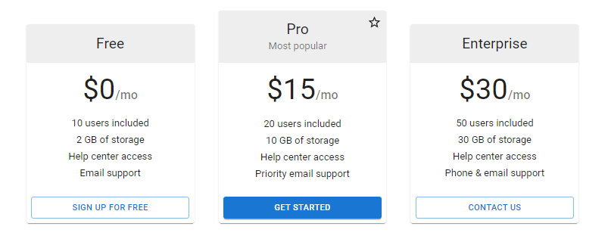
Pricing for special customized gift items

Slide 6
Contact us
Email Address,
Subject,
Your message
Submit Button

Slide 7
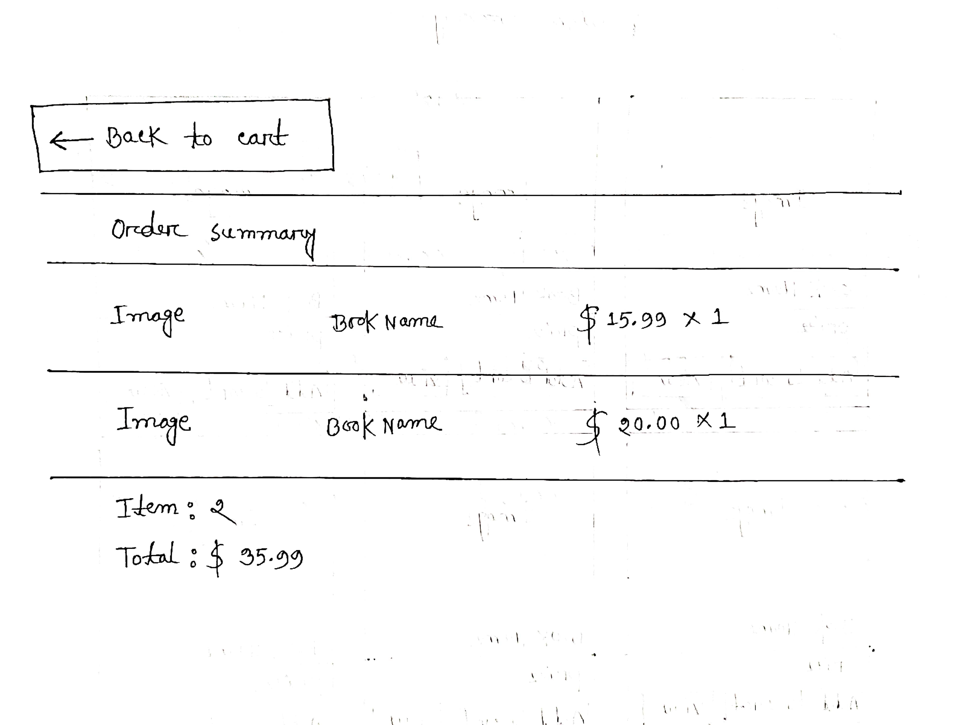
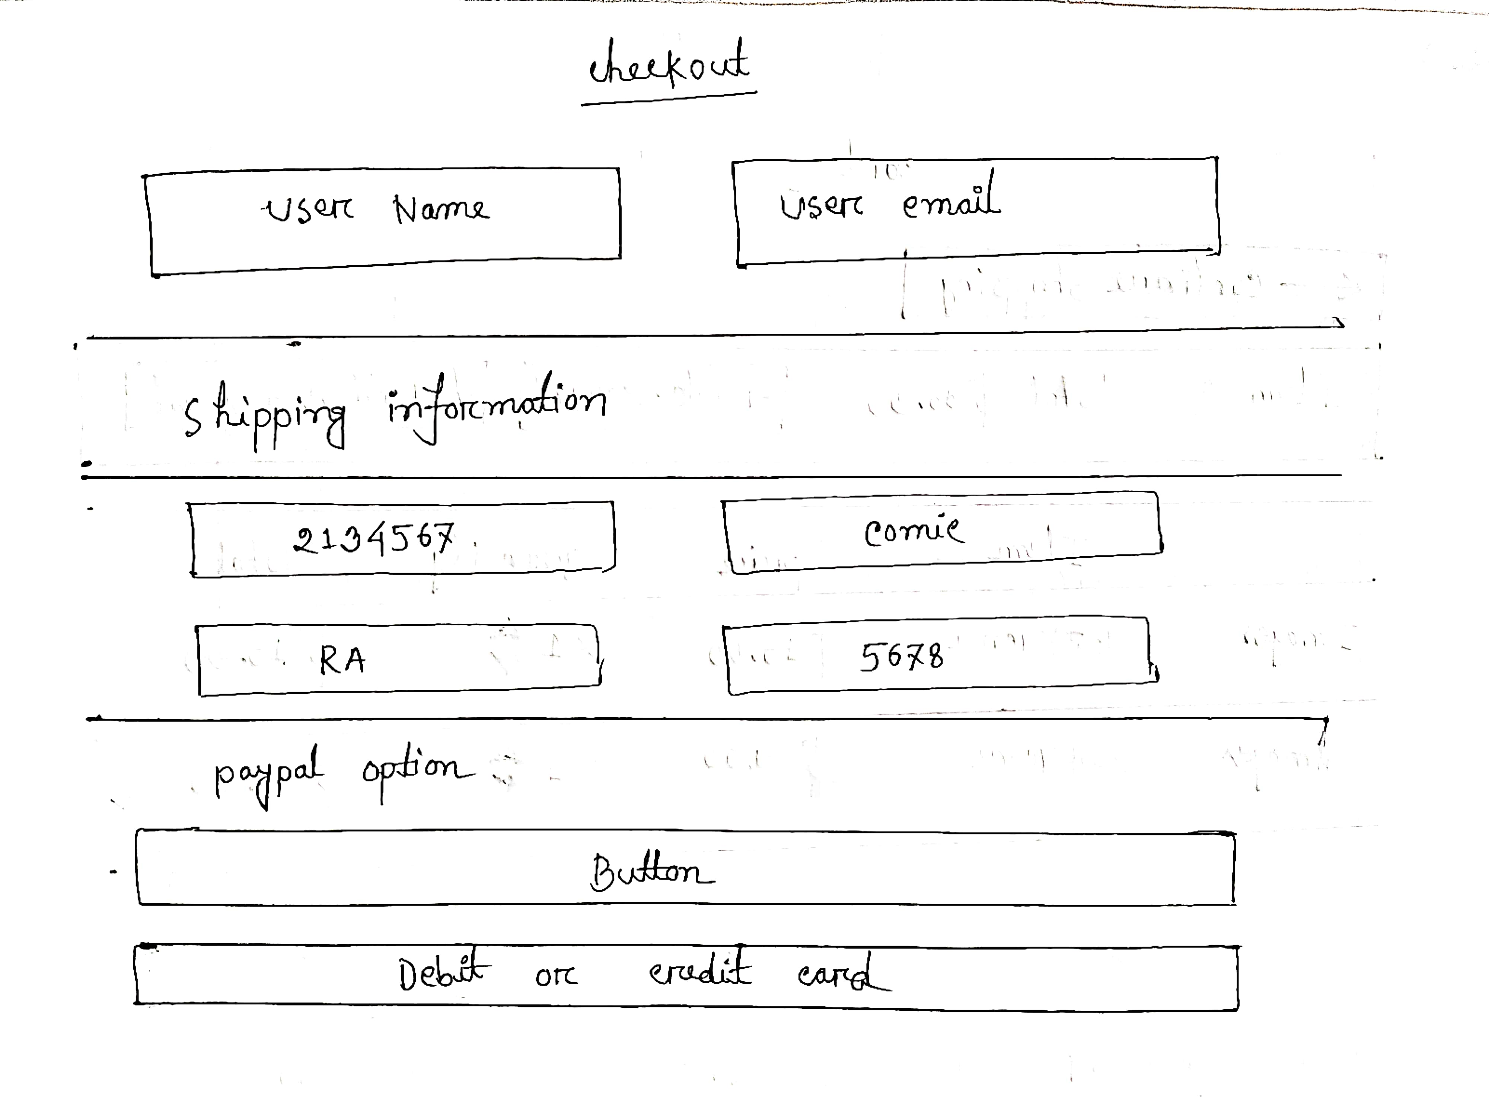
CheckOut
Checkout
Order Summary

Slide 8
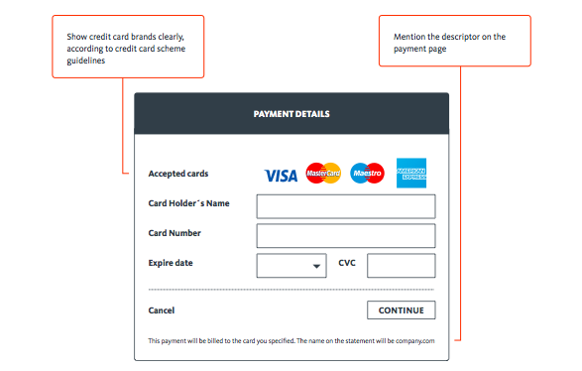
payment

Slide 9
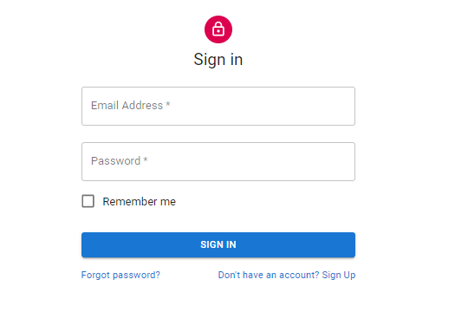
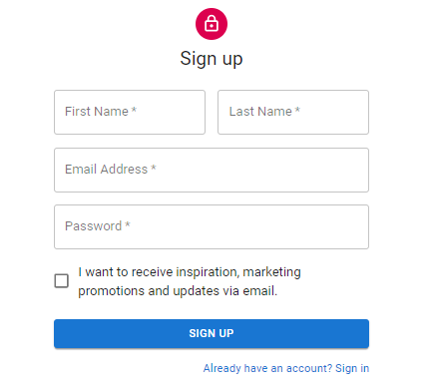
Sign in & sign up

Slide 10
Footer
Service details, Emergency Care,
Our address,
Facebook page, YouTube, twitter icon,
Call Now (+8801xxxxxxxxx)
©2021 Surprise BD. All rights reserved.

